Slide 1



Intelligent Agents
Introduction
Rachid Anane 2013 / Mark Tyers 2016

Slide 2











Pilot Partners

Slide 3


Technical Partners

Slide 4
Scope
The purpose of this module is to present the theoretical foundations of agent technology, and to provide an understanding of the design and implementation of intelligent agents.
A range of application areas will be considered, including domains such as e-commerce and interface agents.

Slide 5
Topics
Intelligent Agents
Artificial Intelligence Models
Belief Desire Intention (BDI)
Agent Communication Language (ACL)
Mobile Agents
Prolog

Slide 6
What is an Agent?
a computer system that is situated in some environment, and that is capable of autonomous action in this environment in order to meet its design objectives’.

Slide 7
Autonomy
Agents operate without intervention of humans or others and have some kind of control over their actions and internal state.

Slide 8
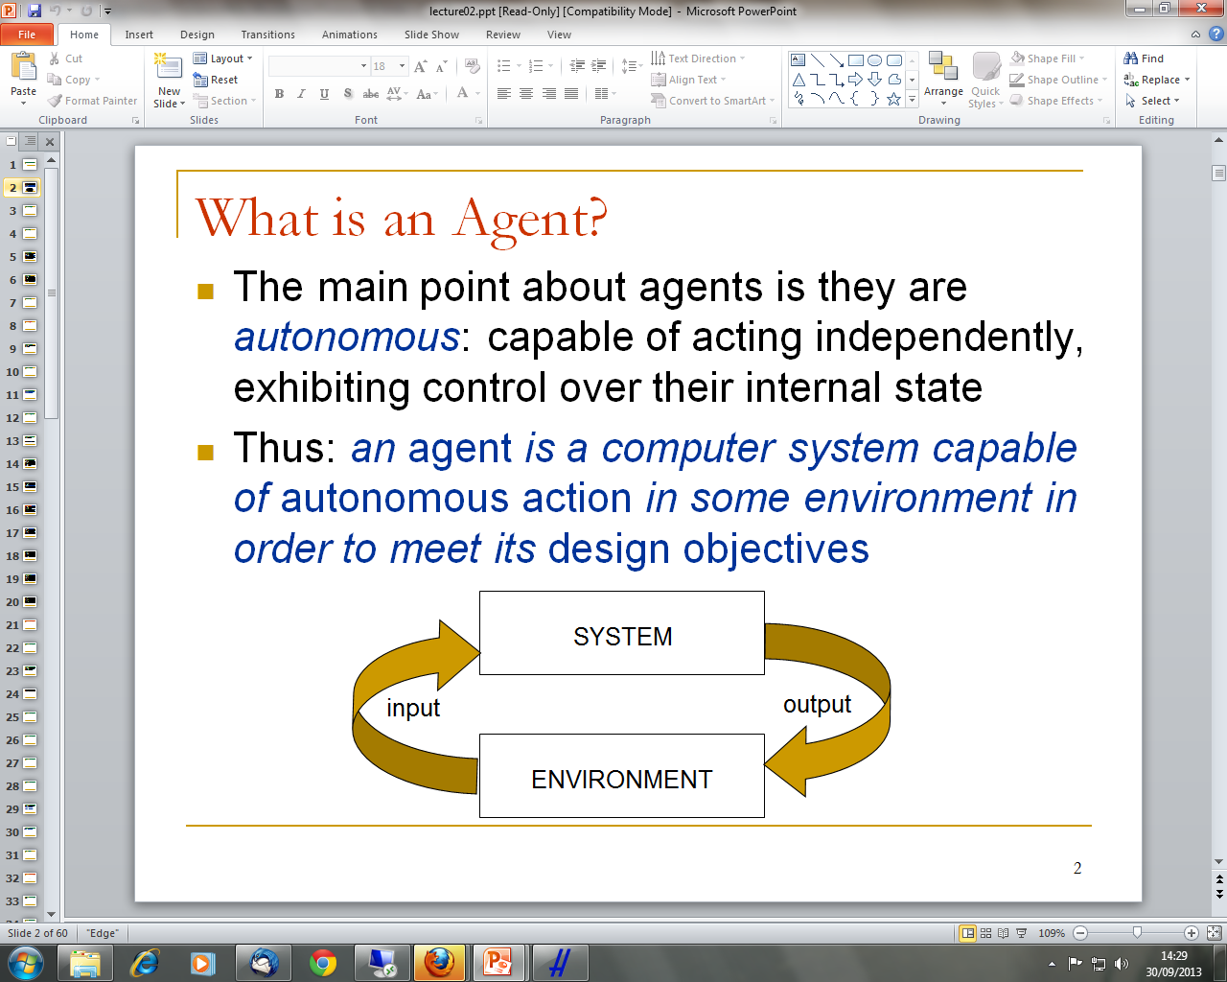
What is an Agent?

Slide 9
Agent Capabilities
An agent is expected to have some core capabilities:
Reactivity
Proactiveness
Social ability

Slide 10
Reactivity
an agent is able to perceive its environment and to respond in a timely fashion to changes that occur in it in order to satisfy its design objectives
Many (most?) interesting environments are dynamic
Agent must take into account possibility of failure – ask itself whether it is worth executing!

Slide 11
Proactiveness
Proactiveness: an agent is able to exhibit goal-directed behaviour by taking the initiative in order to satisfy their design objectives.
Proactiveness = generating and attempting to achieve goals; not driven solely by events; taking the initiative
Recognizing opportunities

Slide 12
Social Ability
An agent is capable of interacting with other agents (and possibly humans) in order to satisfy their design objectives.
The real world is a multi-agent environment: we cannot go around attempting to achieve goals without taking others into account
Some goals can only be achieved with the cooperation of others

Slide 13
Object
Encapsulates some state
Has methods (behavior), corresponding to operations that may be performed on this state
Communicates via message passing

Slide 14
Features of Agents
Autonomous
Smart
Active

Slide 15
Autonomous
Agents embody stronger notion of autonomy than objects, and in particular, they decide for themselves whether or not to perform an action on request from another agent

Slide 16
Smart
capable of flexible behavior, and the standard object model has nothing to say about such types of behavior
Flexible:
Reactive
Proactive
Social

Slide 17
Active
a multi-agent system is inherently multi-threaded, in that each agent is assumed to have at least one thread of active control.

Slide 18
Motivation
objects do it for free
agents do it because they want to or for money

Slide 19
Agent Applications
Types of intelligent software agents:
Buyer agents or shopping bots
User or personal agents
Monitoring-and-surveillance agents
Data-mining agents

Slide 20
Buyer Agents
Travel around a network retrieving information about goods and services such as books, electronic components etc.

Slide 21
User Agents
Sometimes called Personal Agents
Check e-mail of a user
Arrange Schedules (e.g. x.ai)
Assemble customized news reports for a user
Play computer games as the opponent of a user etc.

Slide 22
Monitoring and Surveillance Agents
Observe and report on equipment, usually computer systems, observe competitors' prices and relay them back to the company
NUJ is an example of this.

Slide 23
Data Mining Agents
Use information technology to find trends and patterns in a data warehouse that can be used to increase sales etc.

Slide 24
Topics
Intelligent Agents
Artificial Intelligence Models
Belief Desire Intention (BDI)
Agent Communication Language (ACL)
Mobile Agents
Prolog

Slide 25
Module Texts
Essential Reading
Wooldridge M (2009). An Introduction to MultiAgent Systems - Second Edition. John Wiley and Sons Ltd, May 2009. ISBN 0 47149691X.
Recommended Reading
Stuart Russell, Peter Norvig (2010), Artificial Intelligence: A Modern Approach, 3rd Edition Prentice Hall, 2010, ISBN-13: 9780136042594

Slide 26
Presentations
https://goo.gl/kTrDMP
https://goo.gl/MDNvgW
https://goo.gl/umE3K0
https://goo.gl/UtPU4v
https://goo.gl/GOKI6h
https://goo.gl/ZehiQB
https://goo.gl/tMlyr9

